Slide 1
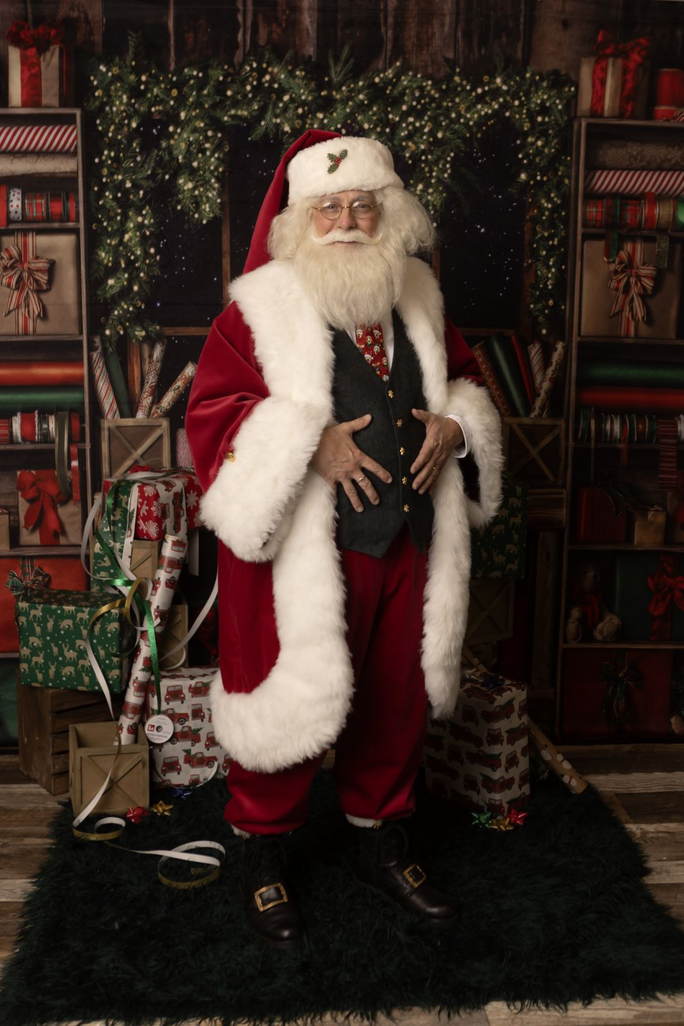
This Christmas, partner with the area’s professional Santa Claus.
BLACK HILLS SANTA:
West River’s Authentic Mr. & Mrs. Claus and St Nicholas ™
www.blackhillssanta.com
Phone: 270-748-3106 Email: Santa@blackhillssanta.com

Slide 2
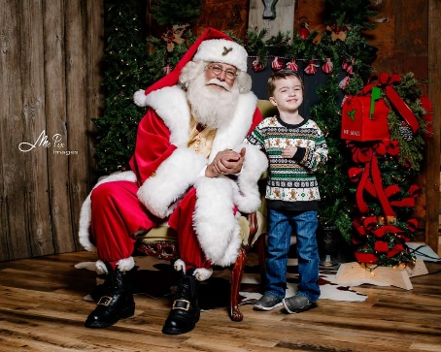
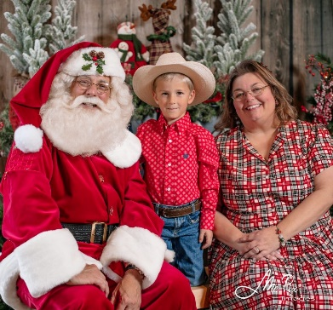
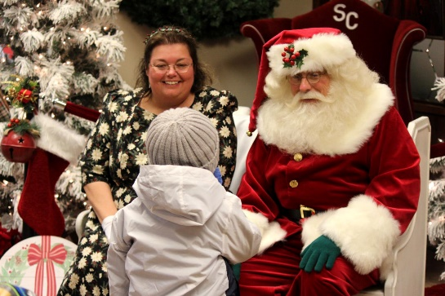
WHO IS BLACK HILLS SANTA?
Black Hills Santa is the home of West River’s authentic Santa & Mrs.. Claus. 2024 is our 27th season bringing the magic and wonderment of Christmas to life for children and families. We are the authentic Christmas figures you know, adore, and desire and we believe it very important those we visit with feel they have spent a magical time with the real Clauses. Professionalism and quality shine through in our outfits, demeanor, and passion for Christmas.
At 3 years old, Black Hills Santa (Jason Rednour-Yeary) visited Santa Claus Land in Santa Claus, IN, beginning a passion for Christmas and Santa. At 16, Jason portrayed Santa for the first time and, once he became a father, Jason regularly portrayed Santa for his children and other young family members before portraying Santa for the US Army, public libraries, and businesses. In 2021 Jason began portraying St Nicholas for area churches. Jason is a member of ClausNet, a professional Santa community, where, in October 2019 and September 2022 Jason was selected as "Member of the Month". He holds an Associates of Santa Claus (International University of Santa Claus, 2018 and 2022), and degrees from Liberty Univ., Regent Univ. School of Law, and Anna Maria College, and is ASL fluent.
Mrs.. Claus (Nicole) met Santa in high school and 30 years later, she keeps everything working properly at the North Pole. She has served as a Girl Scout leader and is always helping out others, like setting up angel trees in Black Hills communities in December. The twinkle in her eye and warm smile conveys the Mrs.. Claus portrayal everyone expects. Mrs.. Claus keeps extra busy raising three kids, conducting homeschooling lessons, and managing the home. For those military families, Mrs.. C, as a Veteran's spouse, knows the whole family serves our nation when a loved one is deployed. Mrs.. Claus has Bachelor of Science in Elementary Education from the University of Southern Indiana. Santa and Mrs.. C’s experience in working with children greatly benefits when they visit with families.

Slide 3
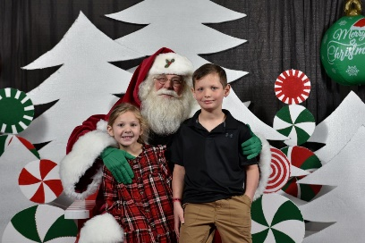
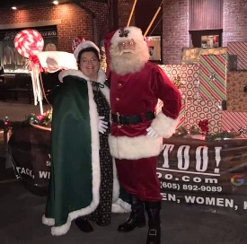
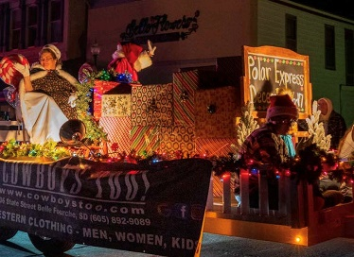
WHY HIRE A PROFESSIONAL SANTA CLAUS?
A professional Santa Claus sets you apart from others. It’s easy to buy a cheap boxed suit, have someone put it on and yell, “Ho-ho-ho”. But ask yourself the following questions:
“Is this person able to handle tough questions from children?”
“Is this person exhibiting professionalism?”
“Will my guests and customers return next year?”
“Does this person know how to address difficult situations?”
“Is this person insured and has he had a background check conducted?”
Our years of experience and knowledge makes us best equipped to address these questions and circumstances. We have a background check completed yearly and carry performer’s insurance to give you peace of mind. A professional Santa Claus is a business partner, asks what your event goals are, and helps you create a magical Christmas event that will ‘WOW’ your attendees. He helps make you and your organization look good.
Example 1: Take a look at a dance school in Rapid City we visit with each year. Every December they have a “Breakfast with Santa”
event that is truly successful with returning and new attendees. Why? Because we partner with them and assist in the design of
the event. We assist in the design of traffic flow and Santa’s set. Families want to visit with a Santa & Mrs. Claus who are invested
in the event, not just being props.
Example 2: Look at the Belle Fourche Chamber of Commerce’s “Light Up the Night Parade”. In 2022 we were invited to be
the Santa and Mrs. Claus for the parade. The response of our arrival on a sleigh was phenomenal. Our float was created by
a downtown retailer but with our input. When we turned the first corner and thousands saw us they went wild. Why?
Because we participated with the attendees and brought the magic of Christmas to them!

Slide 4
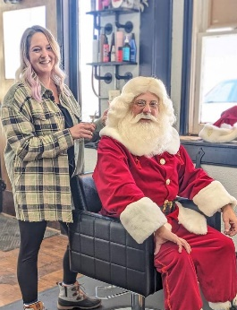
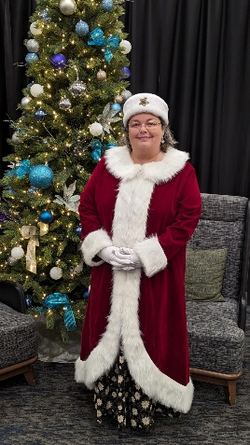
WHAT YOU GET FROM black hills Santa
​​​​Your customers and guests deserve the best and whatever your need for a Santa and Mrs.. Claus, we are the authentic Christmas figures who will make the magic of Christmas come alive for children young and old while exceeding your expectations with professionalism, attention to detail, and a love for Christmas. We will work with you to understand your public relations goals and messages. It takes a special Santa and Mrs. Claus to project their character to hundreds from a great distance or through media. See for yourself, below.
Watch Good Morning KOTA And here is a photo advertisement
Territory” at: for “Untangled” salon.
https://www.youtube.com/
watch?v=s2TuU28Qmv0
In both, we see how Santa projects himself to the viewer. And do you notice the outfit? That is a custom-made suit with custom leather boots and belt. There is nothing fake with Black Hills Santa. And Mrs. C’s dresses are all handmade just for her. This level of authenticity comes through on film and print.
A professional Santa creates a magical experience, creates memories, helps create smiles from the young and old - and even some tears from both.
Santa can really add value from a PR and marketing standpoint. This isn't a job…it's a calling. And I really want to see you do things right and be successful.
WHAT YOU GET
Professionalism
Authenticity
Experience
Partnership
Quality
Value
​
​​​​​

Slide 5
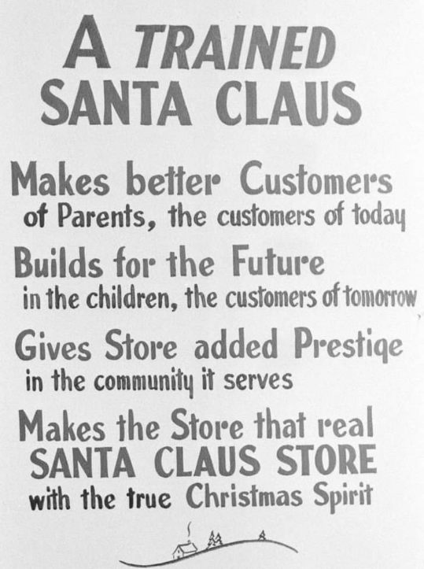
black hills Santa's CORPORATE clients
This sign was posted at Santa School in the 1950s.
It’s message still rings true today.
These fine local businesses have discovered the value and benefits of Black Hills Santa and Mrs.. Claus.
Prima Dance
The Box Elder Events Center
Aieon Photography
ReMax
MePix Images
Rapid City Rush
Rushmore Family Chiropractic
City of Box Elder
Downtown Rapid City
Arrowhead Golf Club
Belle Fourche Chamber of Commerce
Holiday Retirement
Cowboys Too!
Heil Mechanical
Storybook Island
Main Street Square
Rapid City Police Department
Church of St Francis of Assisi
Coral Drive Elementary School
Church of the Immaculate Conception
Piedmont Valley Library
US Army
Girl Scouts
Black Hills Energy

Slide 6
A Few CUSTOMER REVIEWS
"Five stars for Black Hills Santa...Everything about Santa was amazing!!!!Make sure to book him for your event!!!!! He is wonderful!!!"-Michelle E.
"Truly the most caring, professional, authentic Santa. The experience was awesome for everyone, even our older kids said he's the best! -Jamie M.​
"Best Santa! Very professional, arrived on time, and takes time for all his visitors. Santa talks to all the kids & also takes time to listen to what they have to say. Mrs.. Claus is very good with the infants too! Don't hesitate to book them for your holiday festivities." -Kristi F.​
"He is the best Santa around. He visited my daughter at our house and made his visit a truly magical experience for her. She is still smiling and talking about it 3 days later. " -Julie B.​
"Best Santa in the Black Hills! …Loves his enthusiasm and Christmas spirit! He was spot on with the kids, great communication, and was on time! Exactly what I hoped for!"-Shelly S.
"I worked with...Santa and his lovely bride, Mrs.. Claus. He was professional, polite, funny, and brought back the sweet nostalgia of what Christmas dreams are made of..." -Crystal T.
"It was such a wonderful experience for our children! Santa did an amazing job!"-Kaitlin D.​
"Very authentic and professional! I recommend him to anyone that needs a Santa!" -Aaron F.​
"This Santa is amazing! He was so great with my kiddos."-Jennifer V​
"Thank you both so very much! You truly made the event so special and...brought a lot of joy and holiday spirit to the Downtown!"- Maja C.​
"Everyone LOVED you so much!!!! You are the "real deal!!!!"- Samantha W.​
"[My son] couldn't take his eyes off [you]. I'm so happy we have a local Santa to keep the Christmas magic alive for my boy"-Rayne M.
"What a magical day you helped provide!! You are so kind and patient, and it's very clear how much you love doing this!!! " -Amanda L.
"If you want a Santa that truly LOVES Christmas Black Hills Santa is your Santa! "-Heather C.
"The most professional and authentic Santa I've ever had the pleasure of ...experiencing. The kids love him, even the older and more skeptical ones, and...the adults get drawn into the magic!"-Megan E.
​"He just carried the gentle Christmas magic Santa spirit where every kid [felt] he was genuinely delighted with them..." -Carrie R.

Slide 7
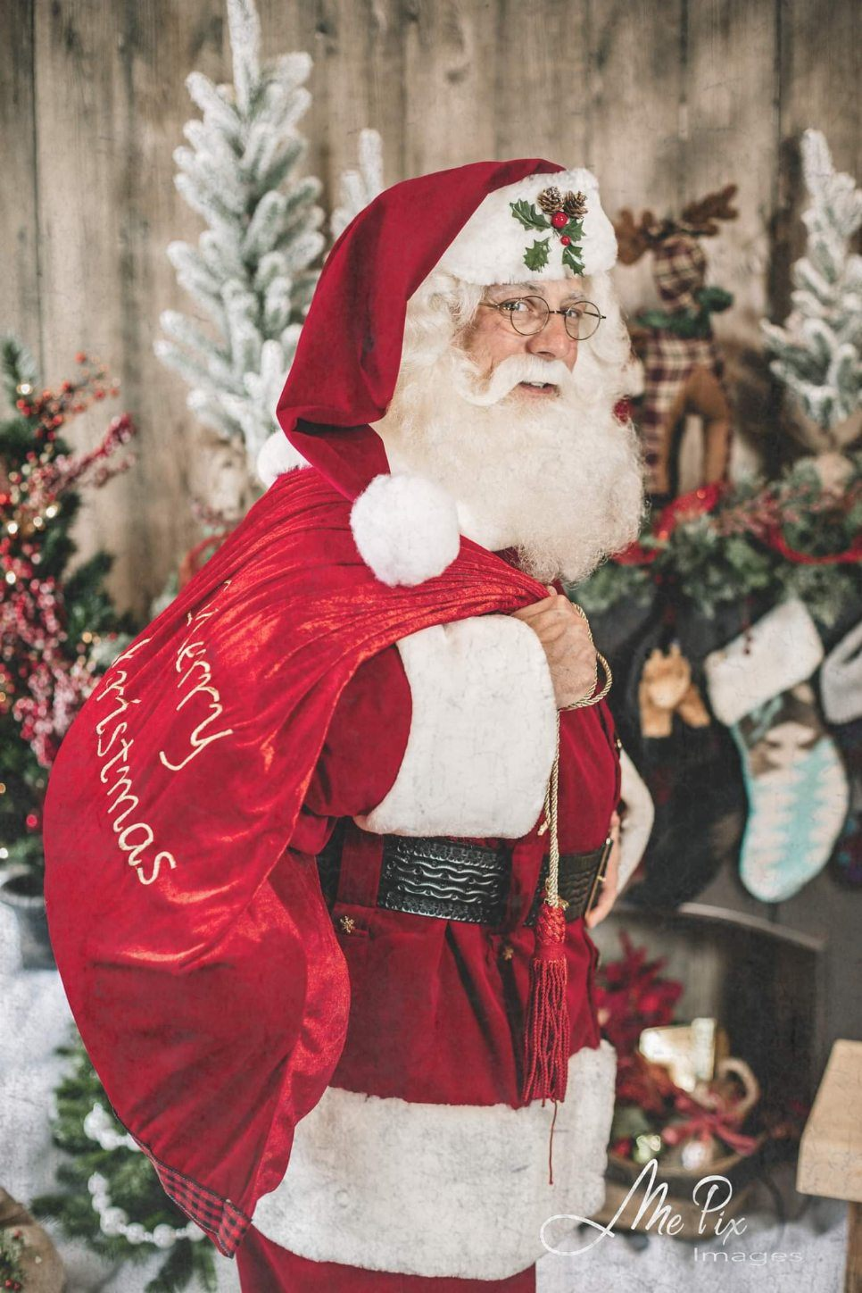
Together, let’s create some magic this Christmas.
BLACK HILLS SANTA:
West River’s Authentic Mr. & Mrs. Claus and St Nicholas ™
www.blackhillssanta.com
Phone: 270-748-3106 Email: Santa@blackhillssanta.com

